Slide 1
Motivation
Humanistic Perspective
Maslow’s Hierarchy
of
Needs

Slide 2
Read the following eight statements and choose those statements that apply to you. There are no right or wrong answers.
A. I am successful in life and/or work, and I’m recognized by my peers for being so. I’m satisfied with the responsibility and role that I have in life and/or work, my status and reputation, and my level of self-esteem.
B. I am part of, and loved by, my family. I have good relationships with my friends and colleagues - they accept me for who I am.

Slide 3
C. Above mostly everything else, I actively seek beauty, form and balance in things around me. My interest in beautiful culture and the arts is central to me.
D. My aim is self-knowledge and enlightenment. The most important thing to me is realizing my ultimate personal potential. I seek and welcome ‘peak’ experiences.
E. I generally feel safe and secure - job, home, etc - and protected from harm. My life generally has routine and structure - long periods of uncontrollable chaos are rare or non-existent.

Slide 4
F. The most important thing to me is helping others to reach their ultimate potential, whatever that may be, even at my own expense.
G. Aside from dieting and personal choice, I never starve through lack of food, nor lack of money to buy food. Aside from the usual trauma of moving house, I have no worry at all about having somewhere to live - I have ‘a roof over my head’.
H Improving my self-awareness is one of my top priorites. The pursuit of knowledge and meaning of things, other than is necessary for my work, is extremely important to me.

Slide 5
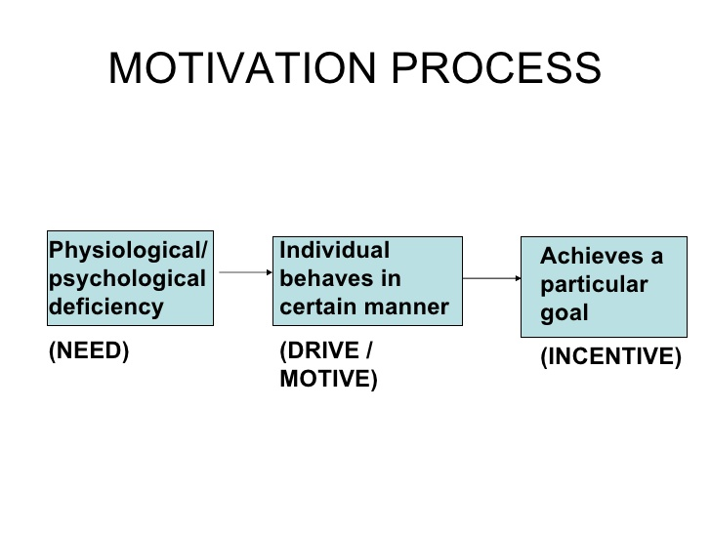

Slide 6
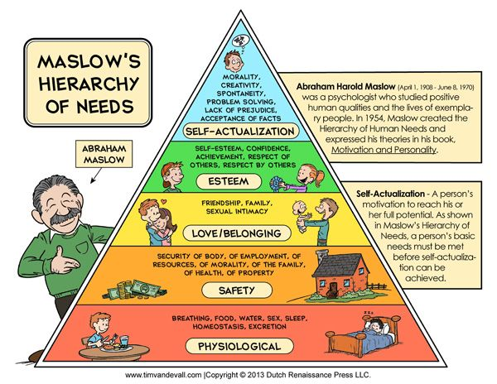

Slide 7
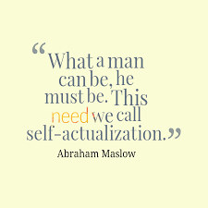

Slide 8
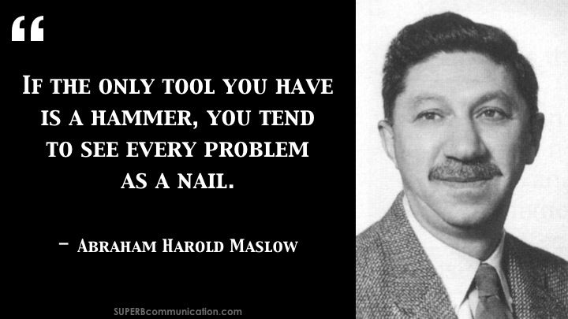

Slide 9
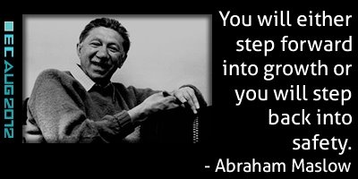

Slide 10
Interpretation:
A: Esteem Needs
B: Belongingness and Love Needs
C: Aesthetic Needs
D: Self-Actualisation Needs
E: Safety Needs
F: Transendence Needs
G: Biological Needs
H: Cognitive Needs

Slide 11
Maslow said that needs 1-4 are deficiency motivators and are generally satisfied in order when the previous need is fully or partially satisfied. If ticked above they are probably satisfied. If a need ceases to be satisfied there is less or no motivation to strive to maintain or satisfy higher level needs. Needs 5-8 are growth motivators. If ticked above they are likely to be a focus of personal growth motivation. This test is based on Maslow’s Hierarchy of Needs.

